Slide 1


Term Project CS 777 Big Data Analytics (Spring 1, 2024) Prof. Dimitar Trajanov, Phd. Facilitator: Nathan A Horak
Prabal Mukherjee
02/24/2024

Slide 2

Enhancing online customer experience using NLP and Recommendation Engine
Test Data Citation
Justifying recommendations using distantly-labeled reviews and fined-grained aspects Jianmo Ni, Jiacheng Li, Julian McAuley, Empirical Methods in Natural Language Processing (EMNLP), 2019 [ http://cseweb.ucsd.edu/~jmcauley/pdfs/emnlp19a.pdf ]
The dataset can be accessed through the following link:
[Amazon Review Dataset](https://cseweb.ucsd.edu/~jmcauley/datasets/amazon_v2/#sample-review ).

Slide 3


Agenda
Introduction
Process
Methodology
Results & Demo
Conclusion

Slide 4
User Experience Online Store
Online store user experience
User search for a product in Natural Language
Search Engine Leverage existing customer review to display search result
Recommendation engine provide more suggestion based on “User like you also like”

Slide 5
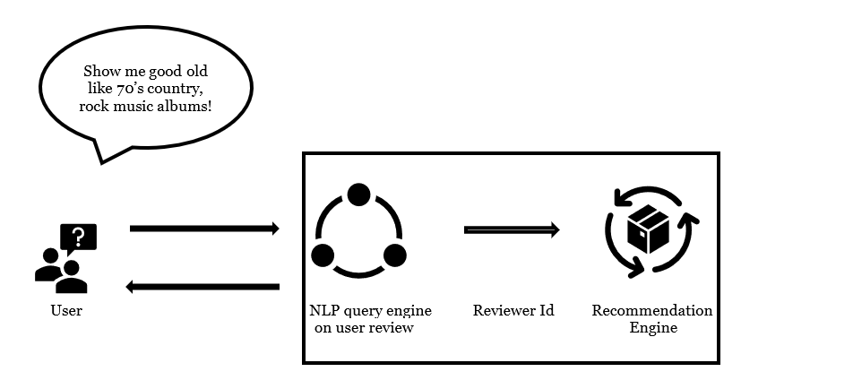
Process Overview

Slide 6
Methodology Search Engine
Used online review text data – Amazon Review Dataset
Data, loaded in spark data frame and cleaned preprocessed
Data Transformed with Transformer pipeline (e.g. Tokenizer, Stopwordsremover, CountVectorizer, TF) and create feature sparse vector
User query also preprocessed and transformed using same Transformer Pipeline
Calculate Cosine Similarity distance between each feature and question
Produced Top “k” result based on sorted distance value.

Slide 7
Recommendation Engine
Reviewer Id’s from previous search result is input to this Engine
Leveraged Collaborative filtering technique with a Pretrained ALS model with same review Dataset
Model produced top10 recommendation for all user of the dataset
This engine filter out result for input reviewer Id
Filtered result send back to user for display as recommendation – “User like you also like”

Slide 8
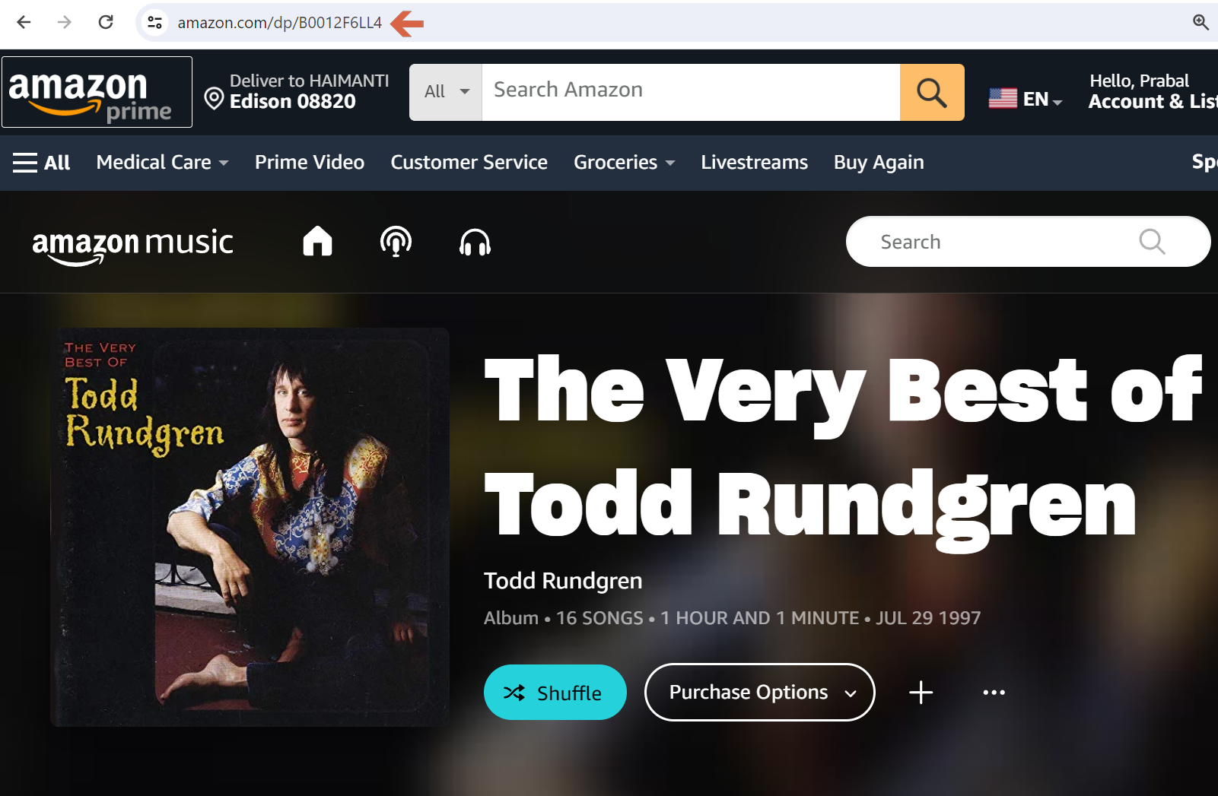
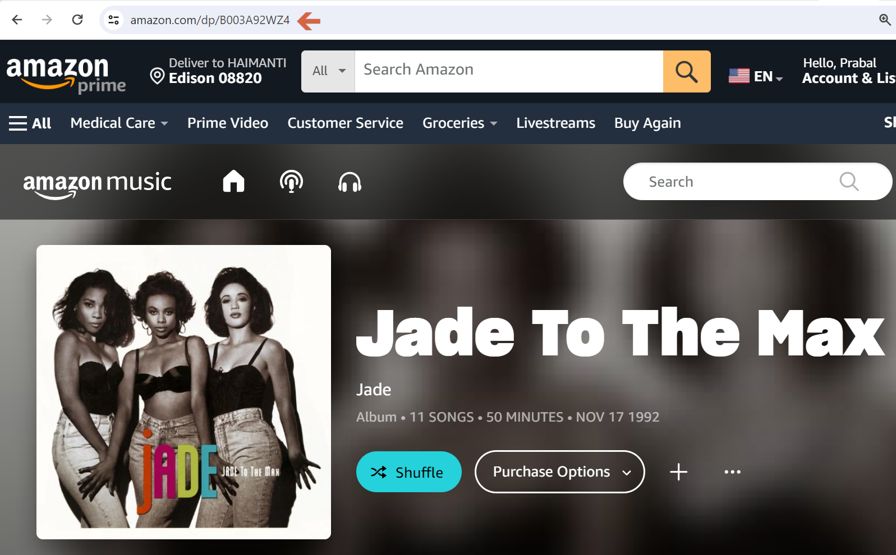
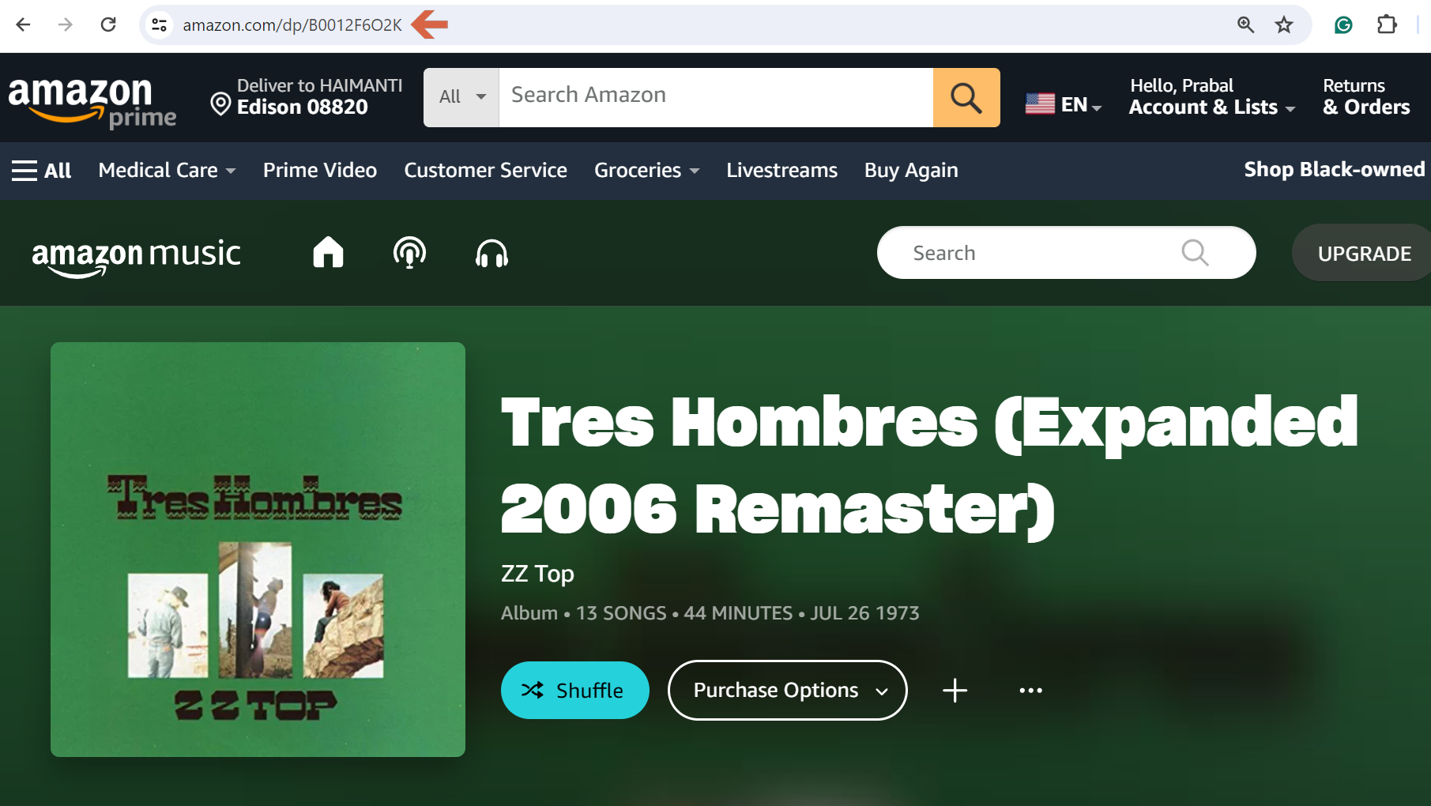
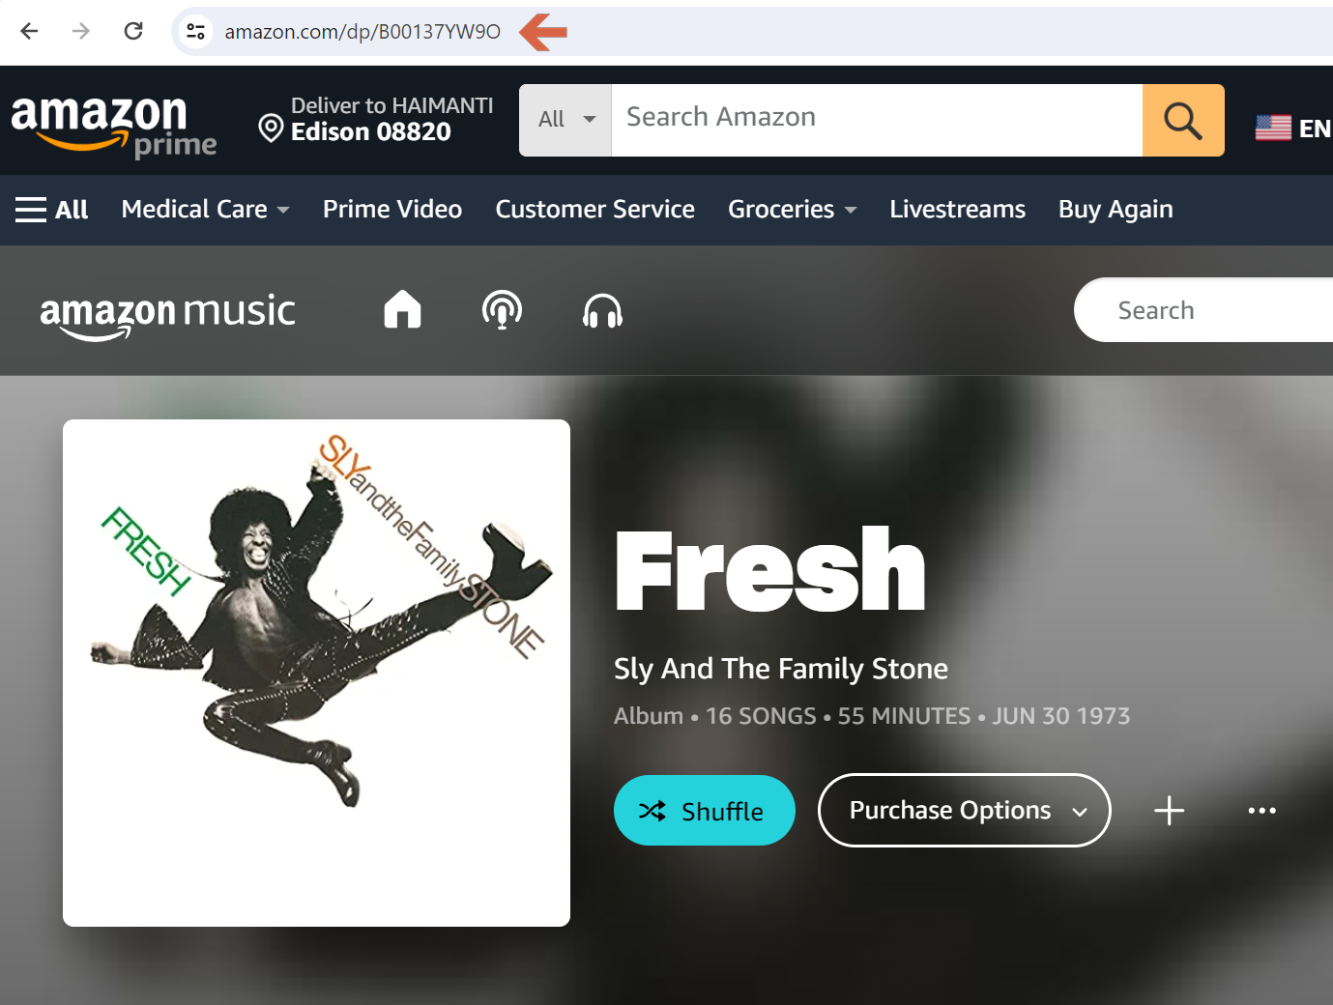
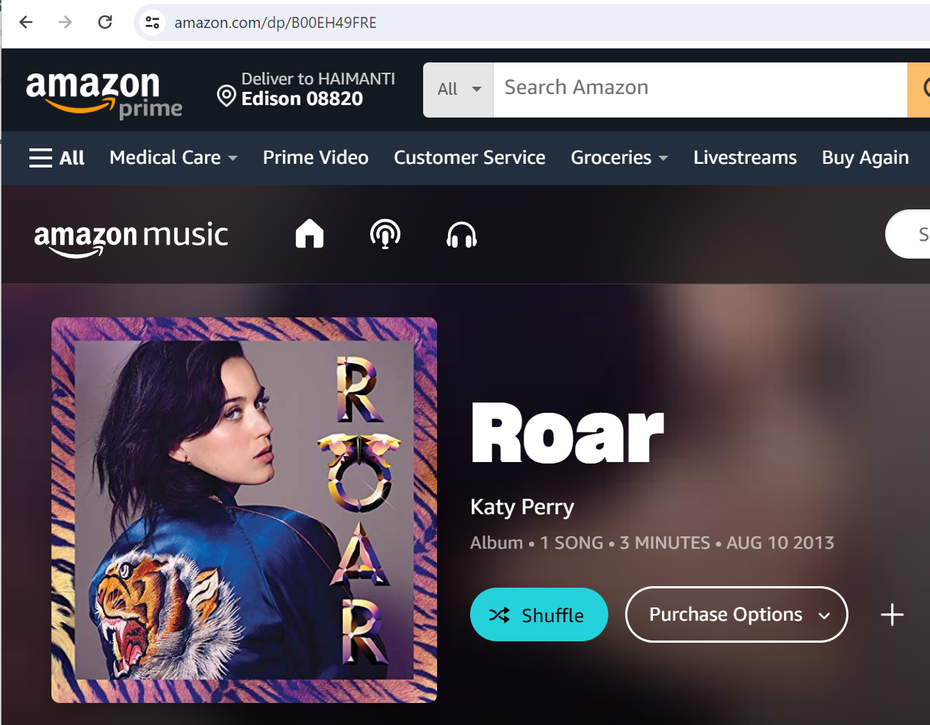
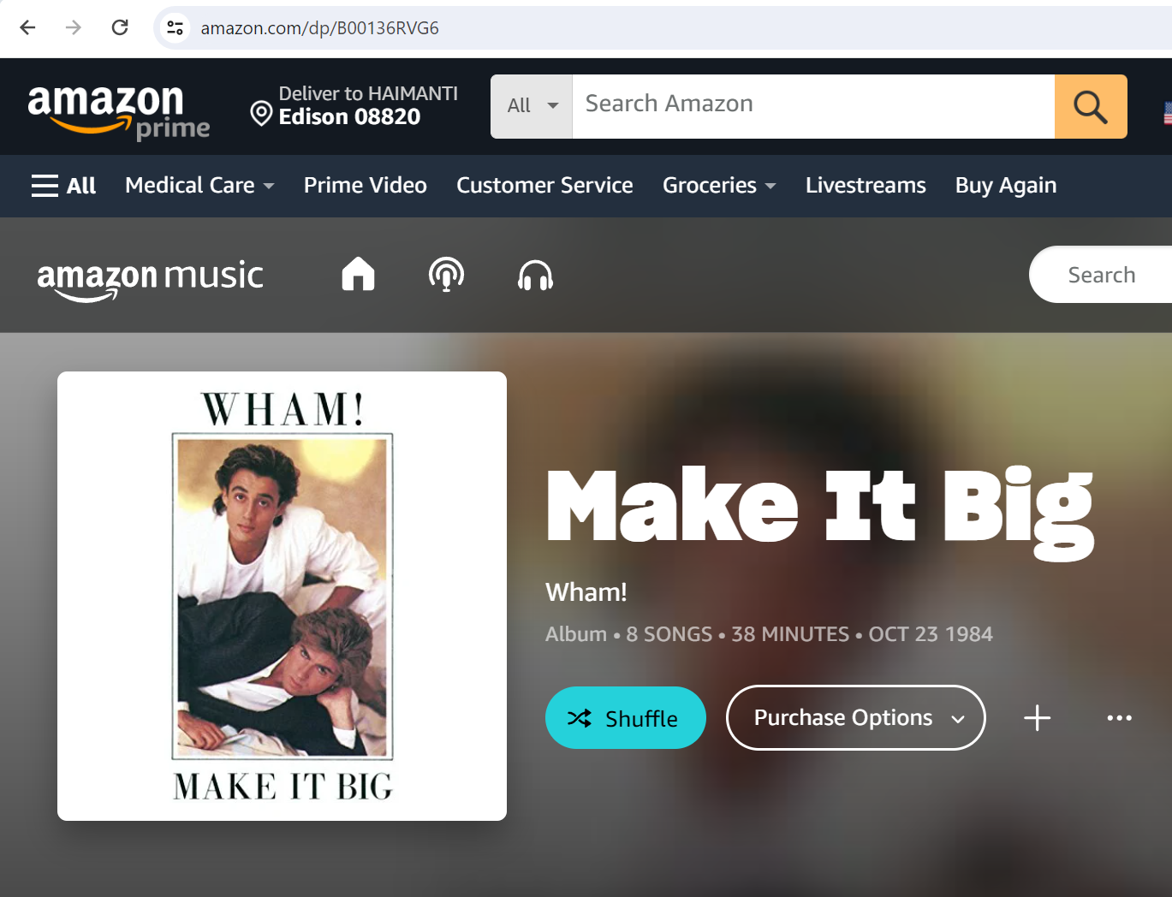
Demo – Sample Query Show me good old like 70’s country, rock music albums!
Some sample of this query
User like you also like

Slide 9
Conclusion
Successfully validated learned technique in real-life use case
Successfully navigated big data challenges using tools like PySpark, Spark MLlib, and SparkNLP
Future work includes enhancing search result query with advanced Spark NLP ML models
Improvement of recommendation queries through efficient summarization techniques
Sincere thanks to Professor Trajanov, my group facilitator Nathan, and Erhan for their continuous support

